Slide 1

Elementary MATLAB® Course – Session 1
Instructor: Sina Ghanbari
Kimia Scientific Group - Chemical & Petroleum Department
Sharif University of Technology
April 2024

Slide 2

Contents
What is MATLAB?
MATLAB Environment
Data Types
Basic Commands
Converting Datatypes Together
Working With Vectors and Matrices

Slide 3


What is MATLAB®
MATLAB is a matrix-based tool for numerical computations. It's very powerful and easy to use.
Both programming language and interactive environment!
Lots of available toolboxes
Notes:
تمام داده‌ها در متلب به شکل یک ماتریس ذخیره می‌شوند. برای مثال یک عدد (اسکالر) به شکل یک ماتریس ۱*۱ ذخیره می‌شود. یک رشته مانند «Whale is the biggest animal» به شکل ماتریسی با یک سطر و چندین ستون (که تعداد ستون‌ها به تعداد کاراکترهاست) ذخیره می‌شود. حتی یک تصویر به شکل یک ماتریس سه بعدی ذخیره می‌گردد که بُعد اول و دوم آن برای تعیین مختصات نقاط و بُعد سوم آن برای تعیین رنگ نقاط استفاده می‌شود. فایل‌های صوتی نیز در متلب به شکل ماتریس‌های تک ستون (بردارهای ستونی) ذخیره می‌شوند؛ بنابراین جای تعجب نیست که متلب مخفف عبارت آزمایشگاه ماتریس باشد.

Slide 4
Advantages and Disadvantages of MATLAB®
Advantages
User-Friendly
Rich Functionality
Disadvantages
Cost (Excludes Toolboxes)
Not Ideal for Large-Scale Projects
Powerful Visualization
Community and Resources
Resource Intensive
Lack of Speed
Notes:
Advantages:
Versatile: MATLAB is a versatile tool, widely used across various scientific and engineering disciplines.
User-Friendly: MATLAB's user-friendly interface makes it accessible to users with varying levels of programming expertise.
Rich Functionality: It offers a vast array of built-in functions, toolboxes, and packages for various applications.
Powerful Visualization: MATLAB excels in data visualization, offering extensive plotting and graphing capabilities.
Community and Resources: A large user community means plenty of resources, forums, and support are available.
Interoperability: MATLAB can seamlessly integrate with other languages like C++, Python, and Java.
Disadvantages:
Cost: MATLAB can be expensive for individuals and smaller organizations, with licensing fees.
Resource Intensive: MATLAB can be resource-intensive, requiring substantial memory and processing power for complex simulations.
Lack of Speed: In certain applications, MATLAB may not be as fast as lower-level languages like C++ or Fortran.
Not Ideal for Large-Scale Projects: It may not be the best choice for large-scale software development due to limitations in scalability.
Limited Multithreading: MATLAB's support for multithreading and parallel processing has limitations.
These points provide a balanced view of MATLAB's strengths and weaknesses, helping your audience make informed decisions regarding its use.

Slide 5
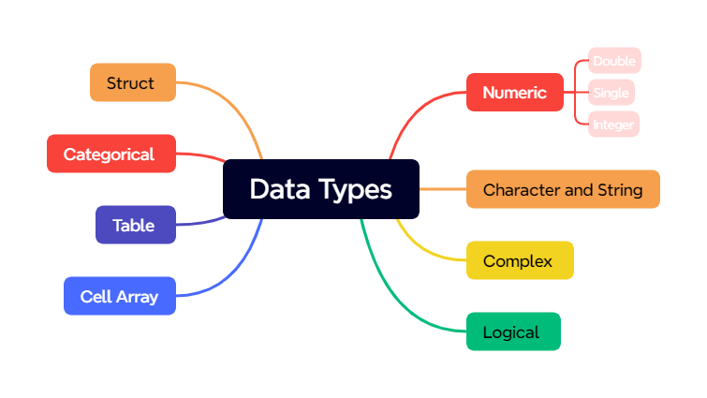

Slide 6
Numeric
Numeric types from memory POV
double | Double-precision arrays
single | Single-precision arrays
int8 | 8-bit signed integer arrays
int16 | 16-bit signed integer arrays
int32 | 32-bit signed integer arrays
int64 | 64-bit signed integer arrays
uint8 | 8-bit unsigned integer arrays
uint16 | 16-bit unsigned integer arrays
uint32 | 32-bit unsigned integer arrays
uint64 | 64-bit unsigned integer arrays
Integer
Float
Complex
Notes:
uint8 represents unsigned integers using 8 bits, allowing values from 0 to 255.
uint16 represents unsigned integers using 16 bits, allowing values from 0 to 65535.
uint32 represents unsigned integers using 32 bits, allowing values from 0 to 4294967295.
uint64 represents unsigned integers using 64 bits, allowing values from 0 to 18446744073709551615.

